Slide 1

Notes:
IQ WIFI Promo

Slide 2
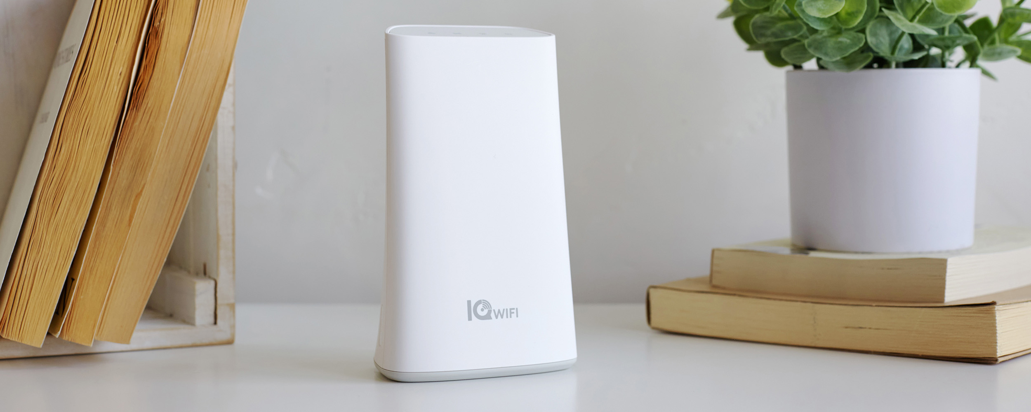
IQ WIFI

Slide 3
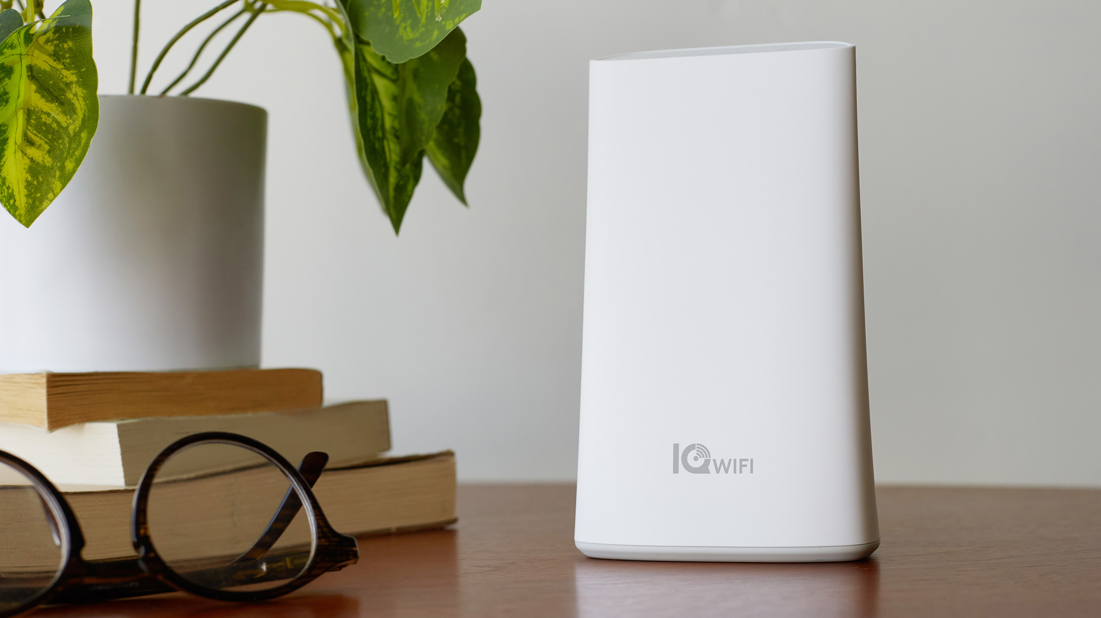

Slide 4
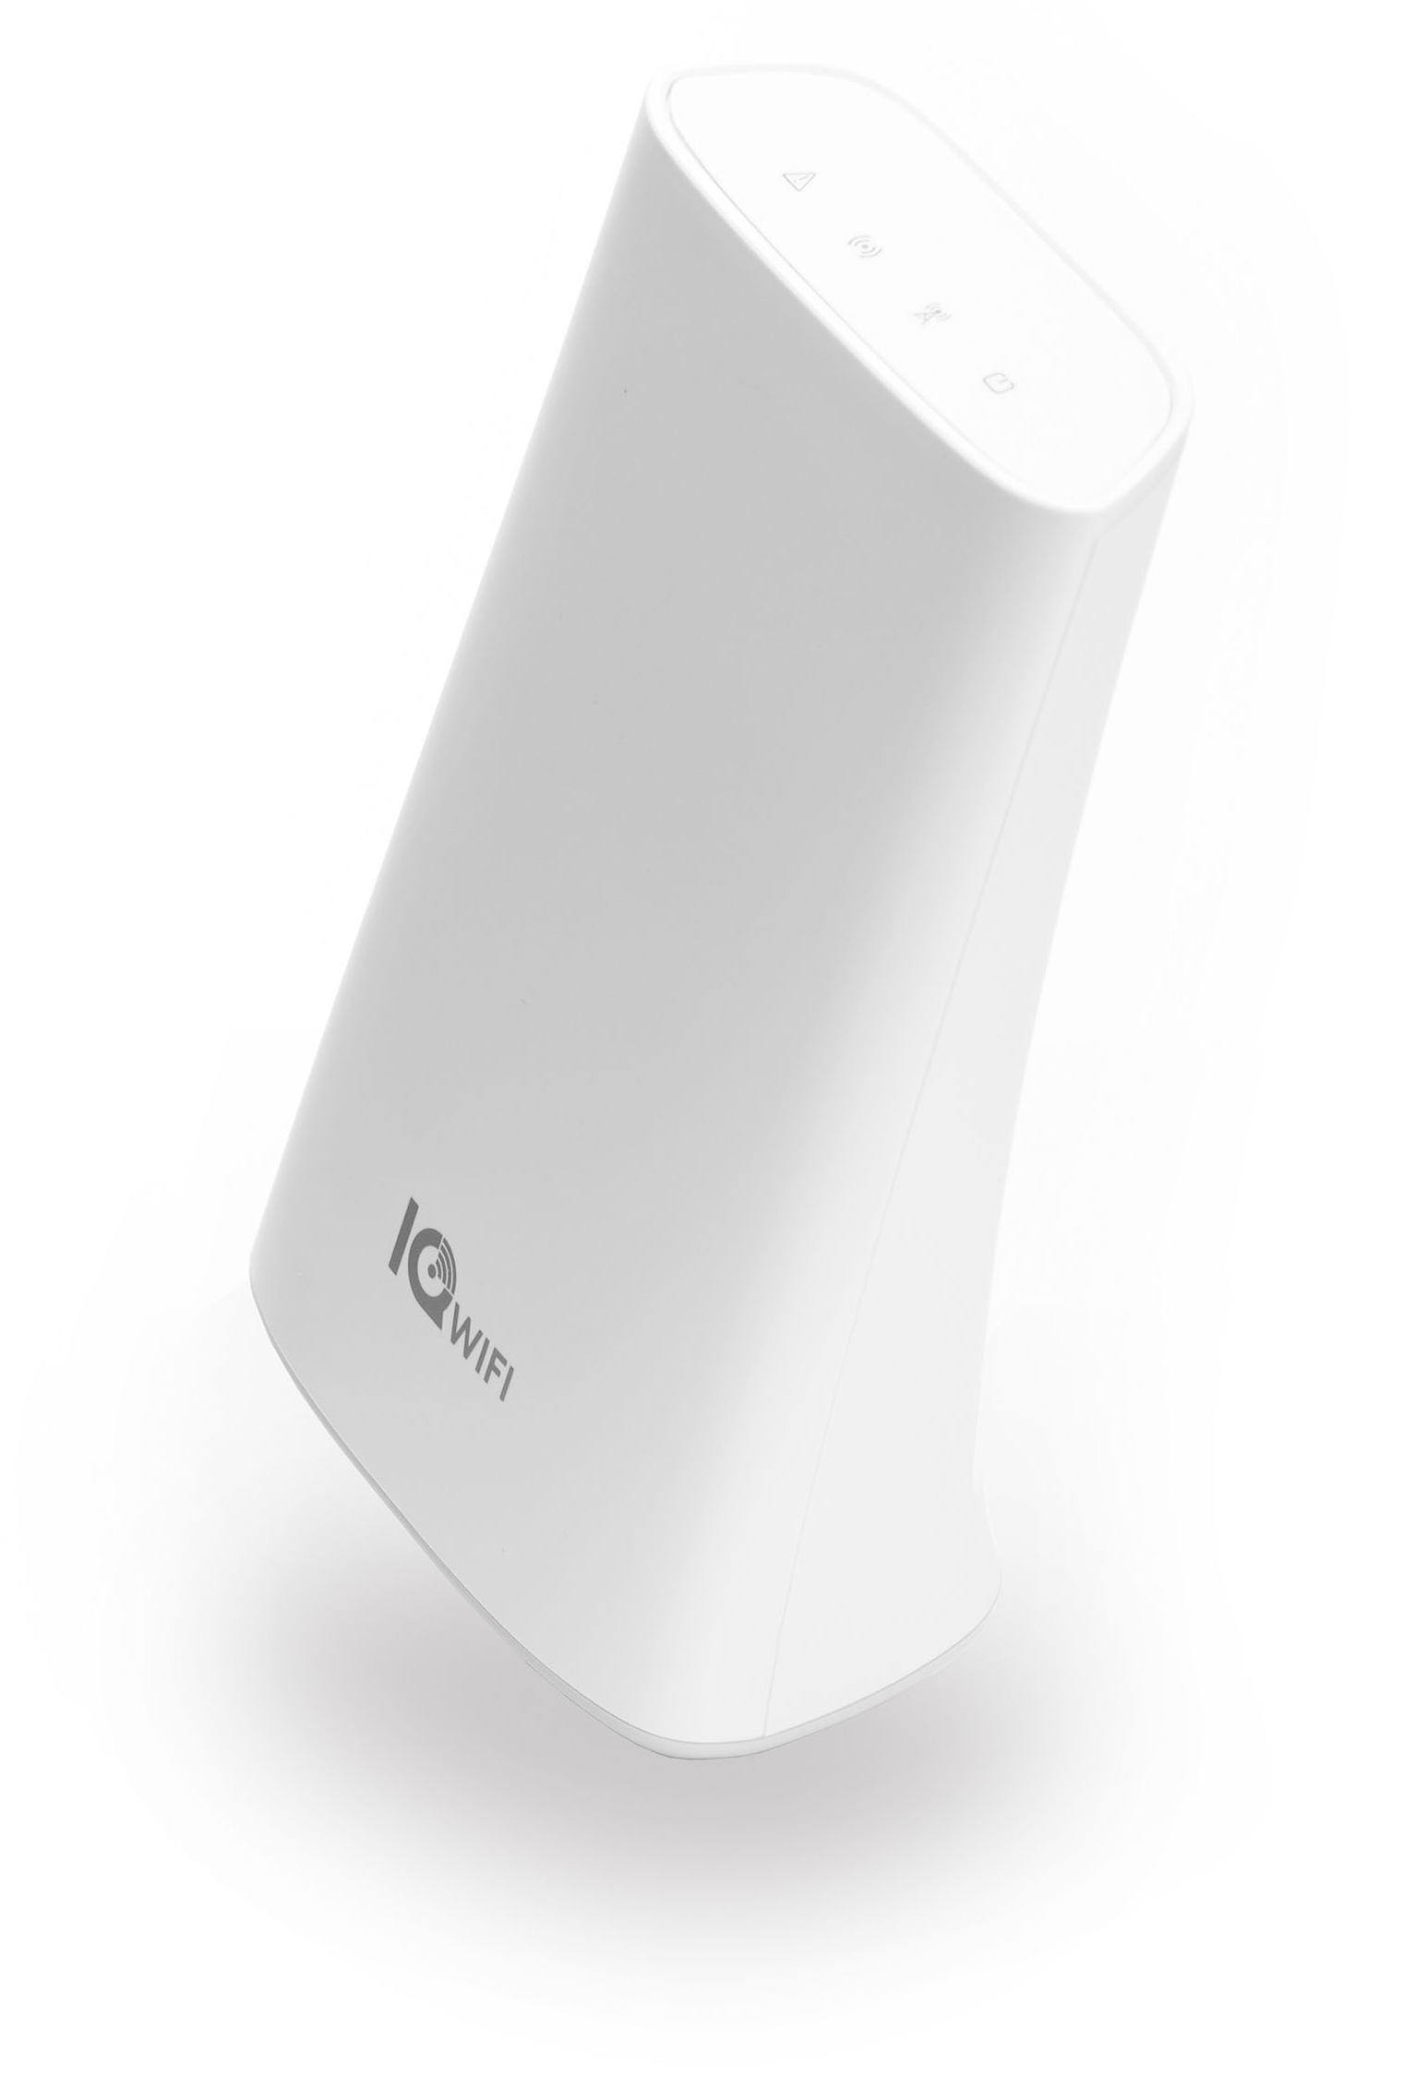
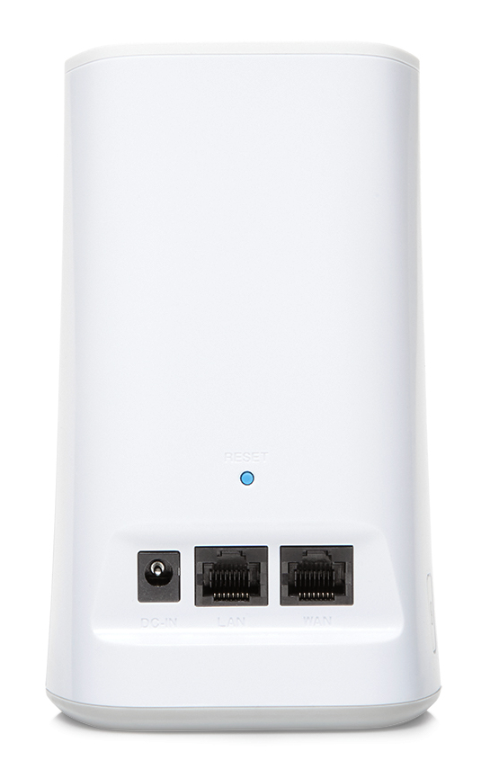
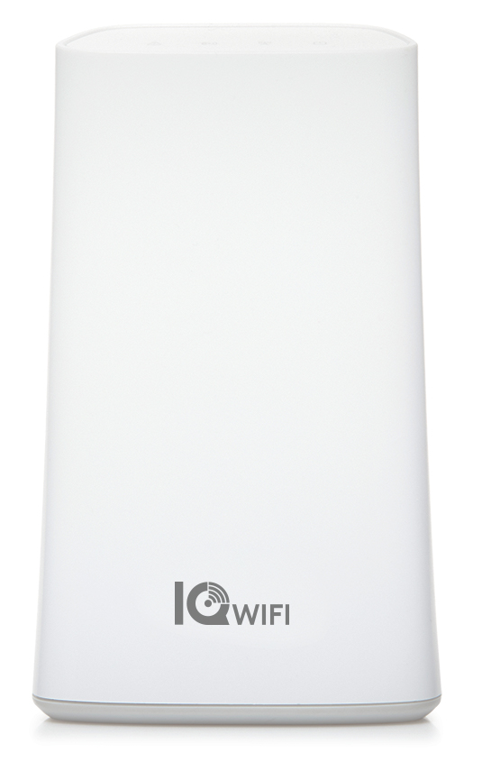

Slide 5
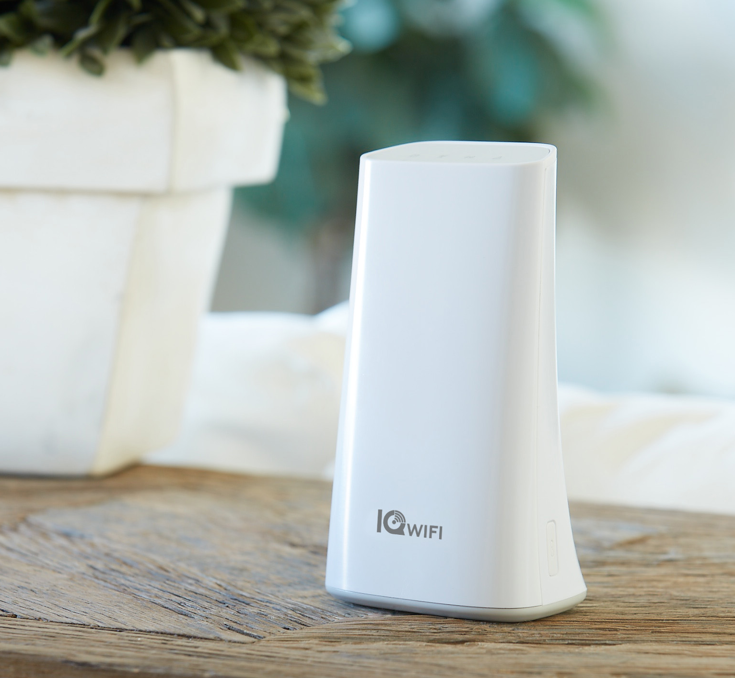
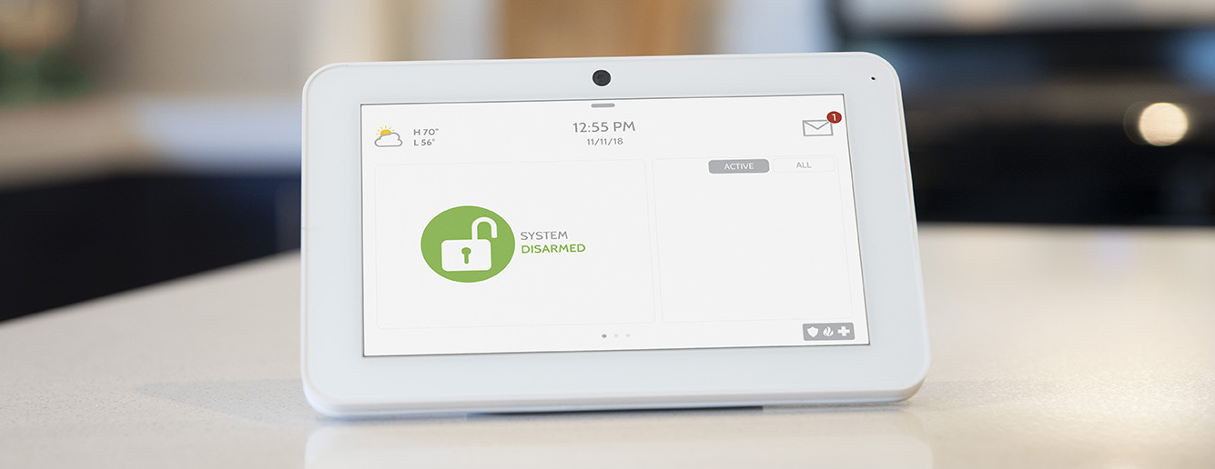
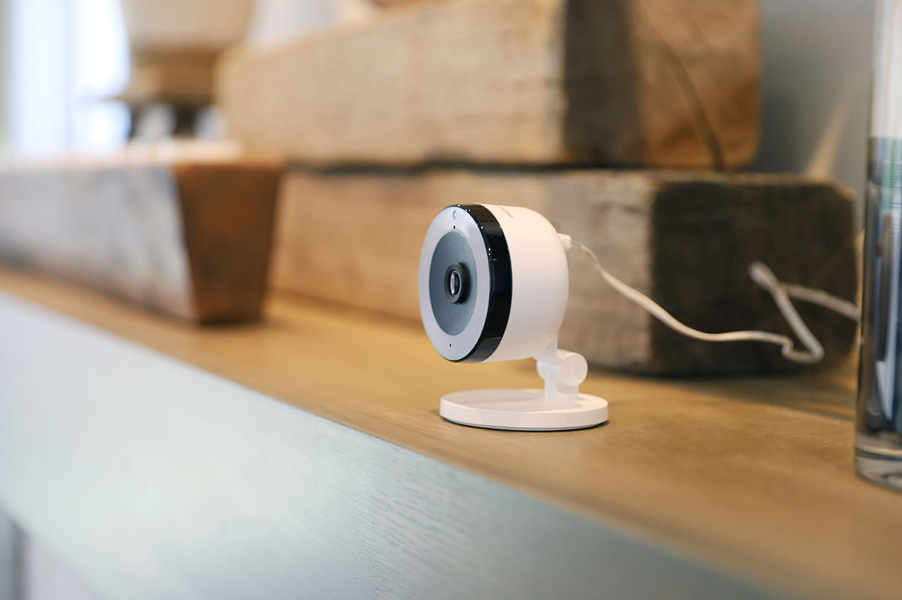
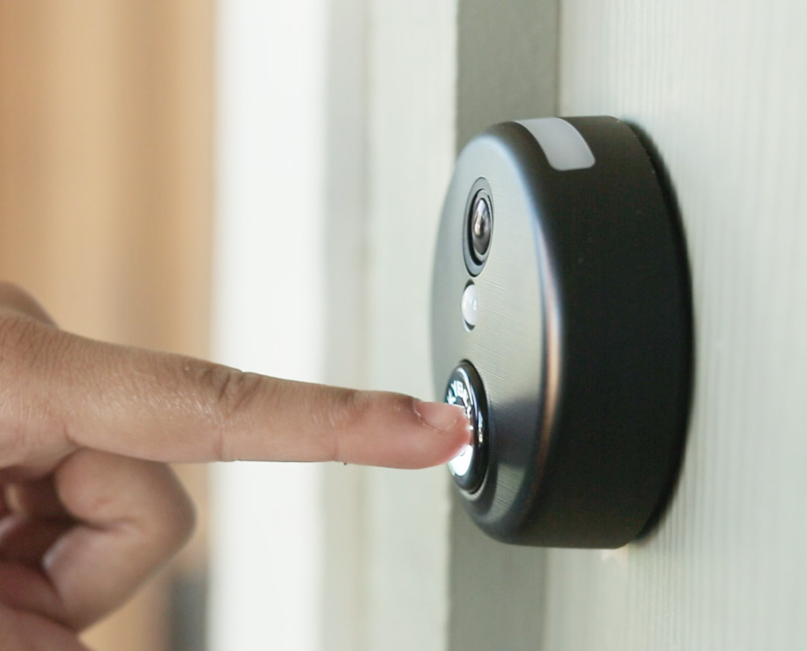
IQ WIFI - Overview
IQ WiFi is a mesh Wi-Fi Router system used to connect Wi-Fi devices such as cameras and Touchscreens inside a home or business.

Slide 6
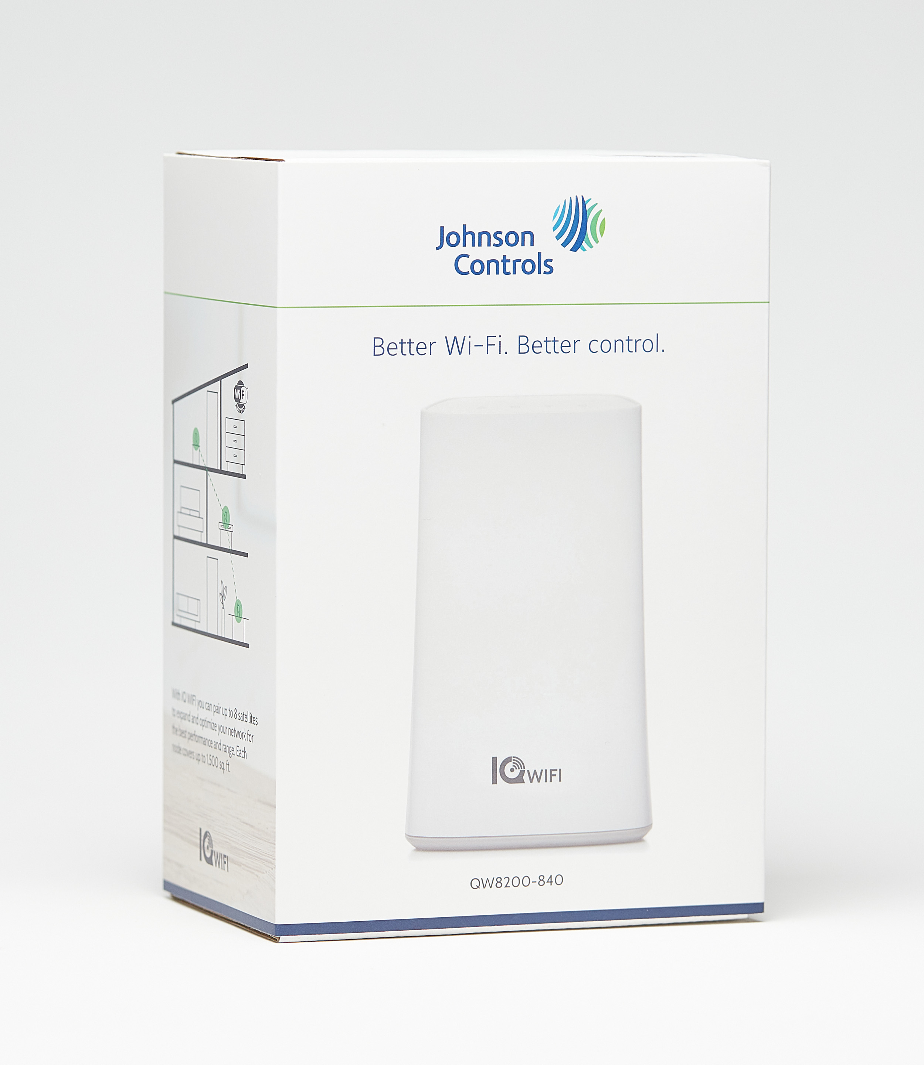
Why did we create it?
Reliability
Improve connectivity for Wi-Fi devices (Indoor/Outdoor cameras, video doorbells, IQ Remotes, etc).
Cost
Dealers are often blamed for bad network connectivity provided by the home/business ISP so they buy competitor products at higher prices (Eero, Google WiFi, etc).
RMR
Give dealers the option to monetize the network support they provide.
Support
Allow remote connectivity to reduce truck rolls.
User Experience
Provide easy install, ongoing maintenance from the IQ Panel.

Slide 7
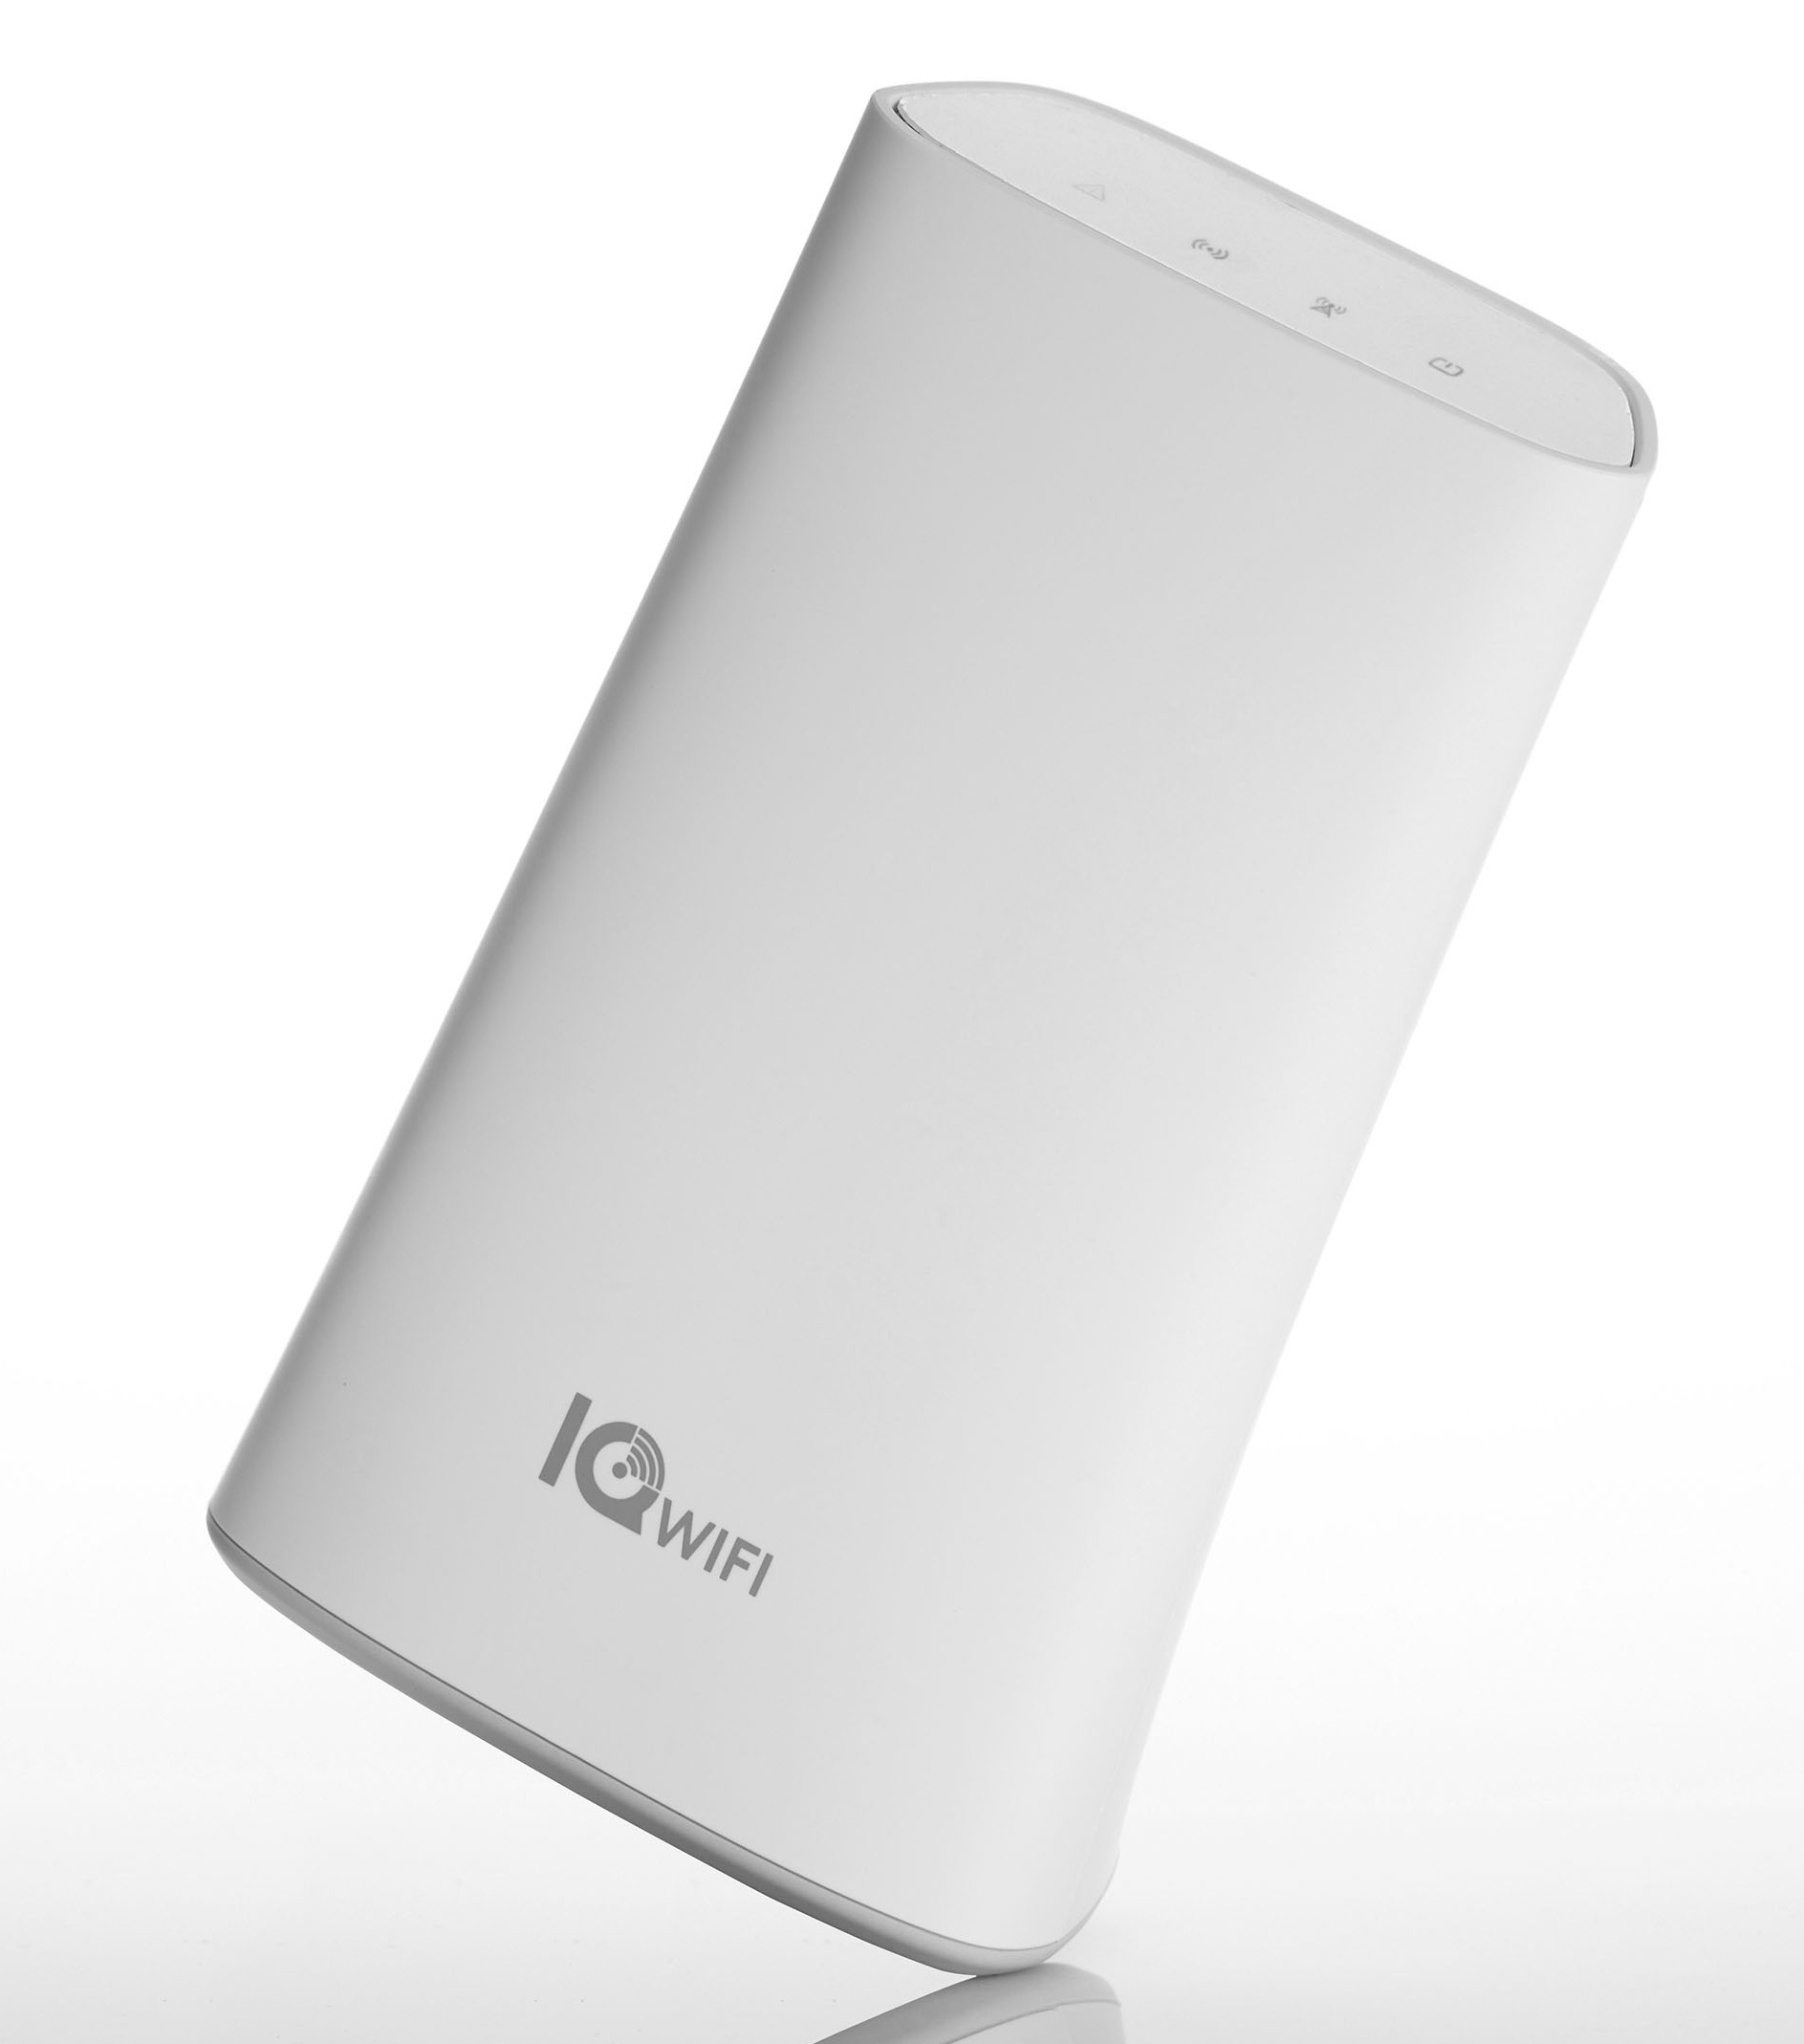
Primary Features
Great Coverage
Get the bandwidth you pay for, everywhere. Replace the existing router with IQ WiFi and add up to 7 additional “Satellites” to blanket your site with reliable connectivity for all your Wi-Fi devices. Each unit covers approximately 1500 sq ft so you can cover almost any home or small business.
Mesh network
Place around your site to create a reliable mesh network that easily expands as you add up to 7 satellites. Fill in “Wi-Fi dead spots” and fix troublesome gaps in service
Automatic Handoff & Self Healing
If Wi-Fi devices are moved, the mesh network automatically passes connectivity to the closest satellite to provide the best, most reliable connectivity. If connectivity is lost on one satellite the others will maintain the connection while it automatically fixes the problem in the background
Easy installation
Using the IQ Panel’s on-screen wizard you can easily connect and configure the primary router and secondary satellites, create primary and guest networks, and manage connectivity and devices.

Slide 8


Slide 9
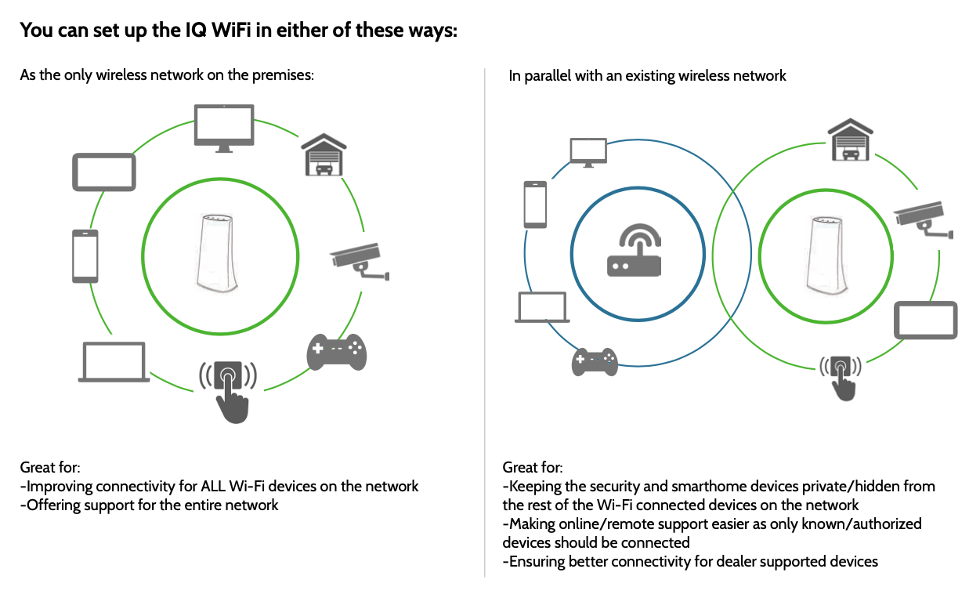
Installation Options

Slide 10
Notes:
WIFI Installation Video

Slide 11
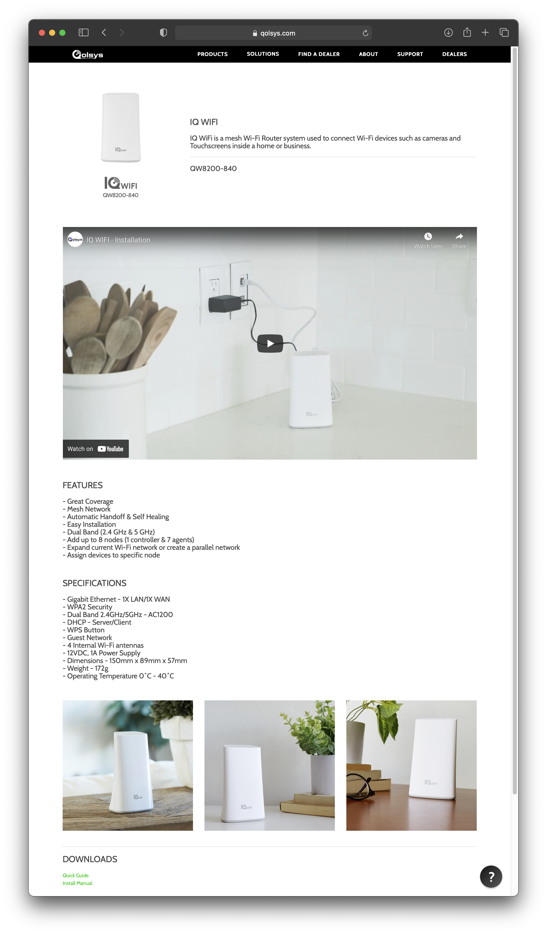
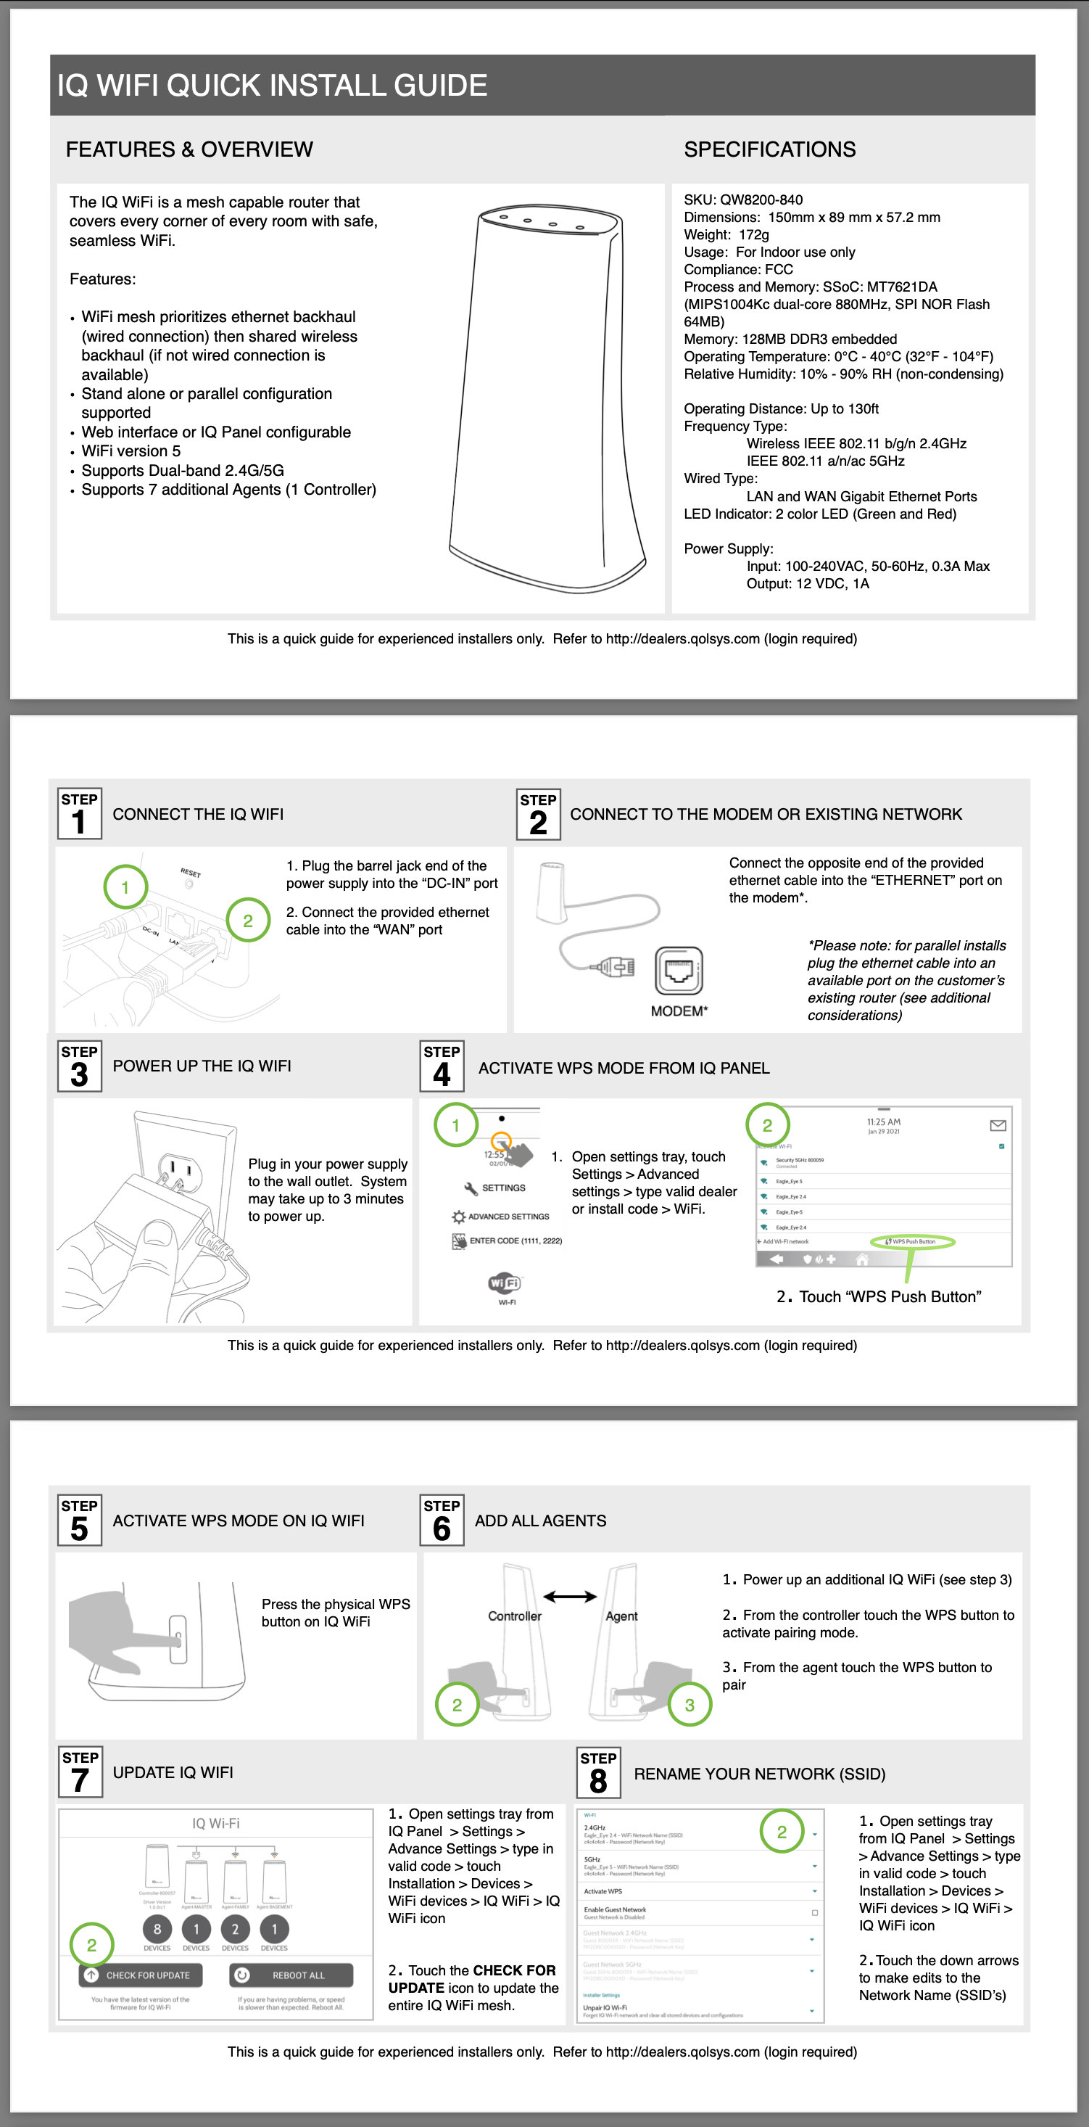
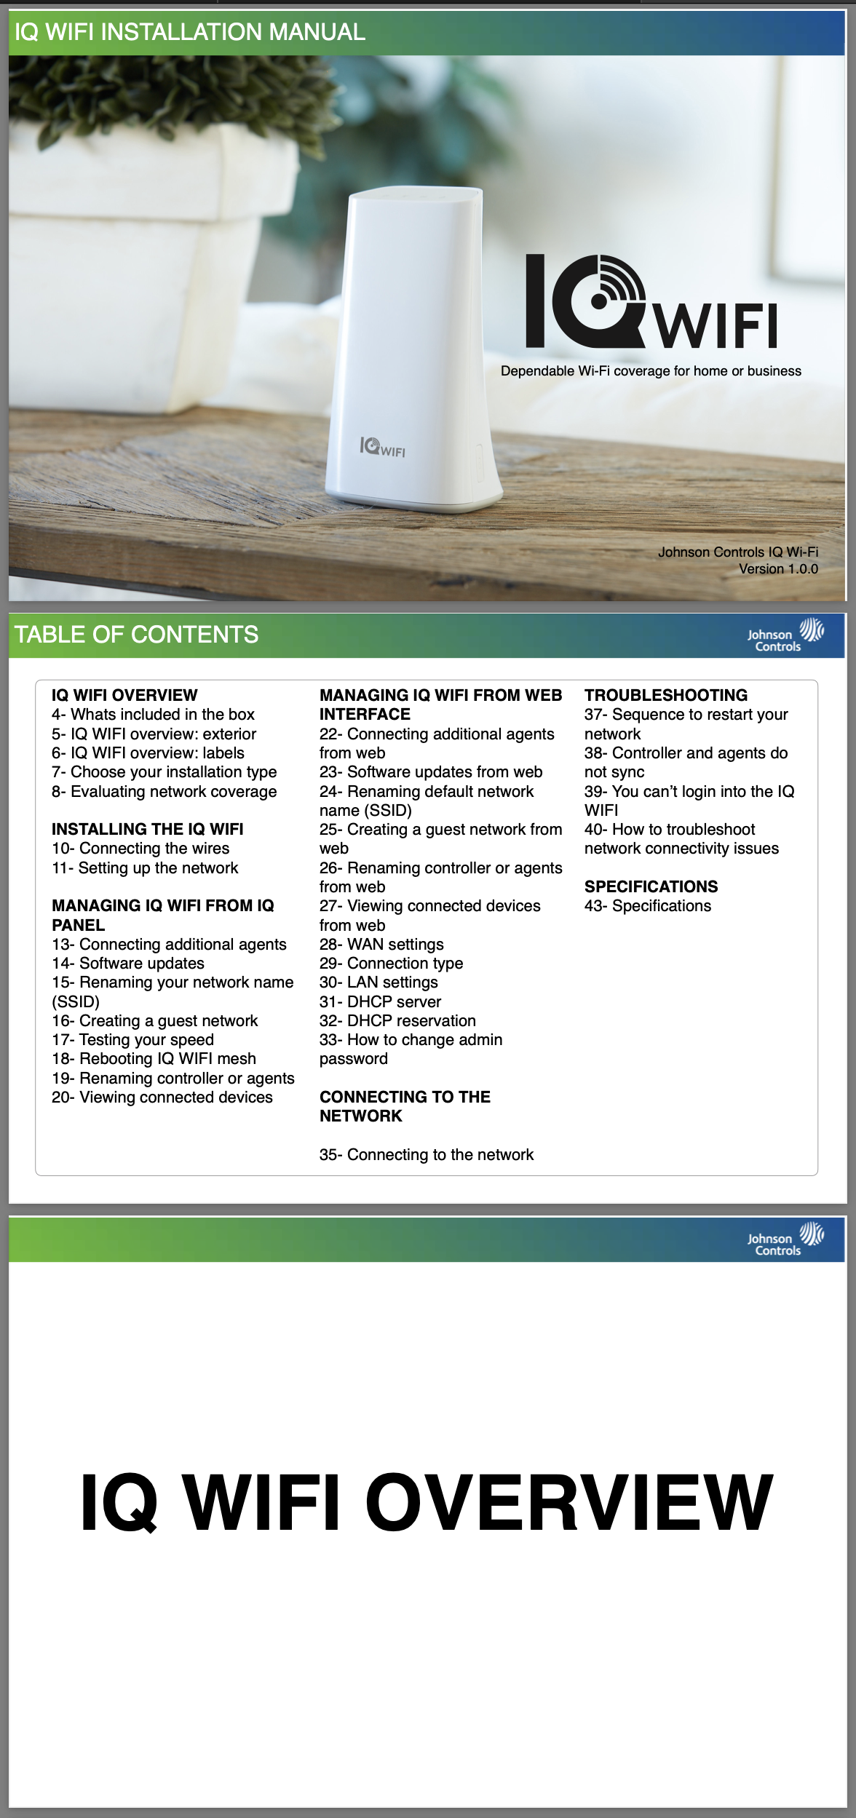
https://qolsys.com/iq-wifi/

Slide 12
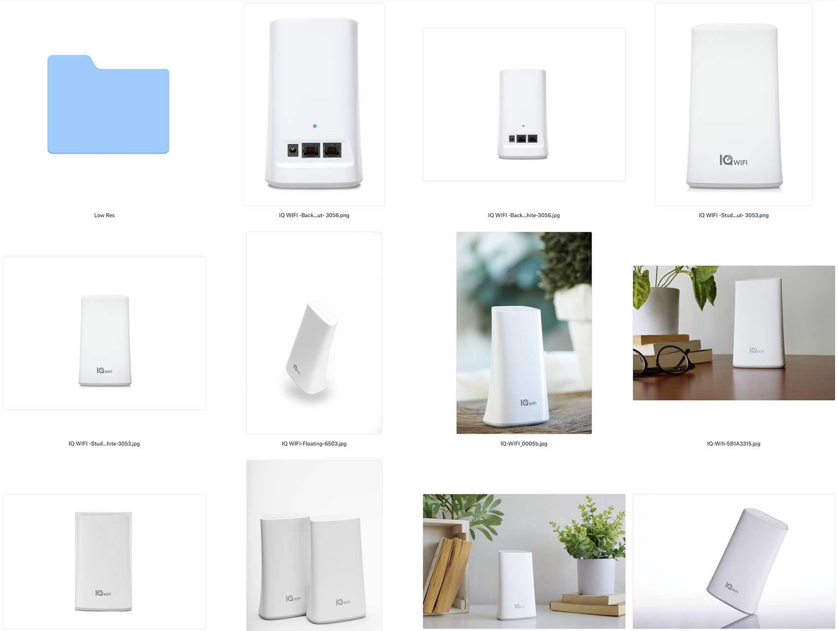
IQ WIFI Photo Library
https://www.dropbox.com/sh/4rfsga91sh98avo/AABMWLZ30FkkGH8bkBjSct8ha?dl=0

